Slide 1
Working with Other Canvas Types
Notes:
Schedule: Timing Topic
45 minutes Lecture
40 minutes Guided Practice
85 minutes Total

Slide 2
Objectives
After completing this lesson, you should be able to do the following:
  Describe the different types of canvases and their relationships to each other
  Identify the appropriate canvas type for different scenarios
  Create an overlay effect by using stacked canvases
  Create a toolbar
  Create a tabbed interface
Notes:
Introduction
Overview
In addition to the content canvas, Oracle Forms Developer enables you to create three other canvas types. This lesson introduces you to the stacked canvas, which is ideal for creating overlays in your application. It also introduces you to the toolbar canvas and the tabbed canvas, both of which enable you to provide a user-friendly GUI application.

Slide 3
Overview of Canvas Types
Content canvas
Horizontal toolbar
Vertical
Stacked
toolbar
canvas
Tab
x
y
z
Tab
page
Notes:
Overview of Canvas Types
In addition to the content canvas, Forms Builder provides three other types of canvases that are:
Stacked canvas
Toolbar canvas
Tab canvas
When you create a canvas, you specify its type by setting the Canvas Type property. The type determines how the canvas is displayed in the window to which it is assigned.
Instructor Note
Demonstration
Open the win_demo.fmb form and run it with the runtime preferences setting ?config=test, so that it will run with useSDI=no.
In the run-time session, move the yellow and purple windows around. In the gray window, point out the gray content canvas and the green toolbar. Scroll the blue and red stacked canvases using the scrollbars. Switch between the different windows by using the mouse. Point out the MDI parent window; there is no MDI toolbar in this form.

Slide 4
The Stacked Canvas
  Displayed on top of a content canvas
  Shares a window with a content canvas
  Size:
    Usually smaller than the content canvas in the same window
    Determined by viewport size
  Created in:
    Layout Editor
    Object Navigator
Notes:
The Stacked Canvas
What is a stacked canvas?
A stacked canvas is displayed on top of, or stacked on, the content canvas assigned to a window. It shares a window with a content canvas and any number of other stacked canvases. Stacked canvases are usually smaller than the window in which they display.
Determining the size of a stacked canvas
Stacked canvases are typically smaller than the content canvas in the same window. You can determine the stacked canvas dimensions by setting the Width and Height properties. You can determine the view dimensions of the stacked canvas by setting the Viewport Width and Viewport Height properties.
Note: If a data block contains more items than the window can display, Forms scrolls the window to display items that were initially not visible. This can cause important items, such as primary key values, to scroll out of view. By placing important items on a content canvas, then placing the items that can be scrolled out of sight on a stacked canvas, the stacked canvas becomes the scrolling region, rather than the window itself.

Slide 5
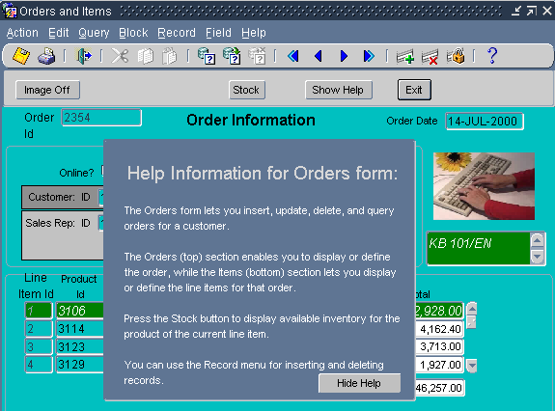
The Stacked Canvas
1
2
3
4
5
Notes:
The Stacked Canvas (continued)
The stacked canvas displays on the content canvas. You can see the following elements depicted in the slide:
1. Content canvas
2. Stacked canvas
3. Viewport X/Y position
4. Viewport height
5. Viewport width
Uses and benefits of stacked canvases
With stacked canvases you can achieve the following:
Scrolling views as generated by Oracle Designer
Creating an overlay effect within a single window
Displaying headers with constant information, such as company name
Creating a cascading or a revealing effect within a single window
Displaying additional information
Displaying information conditionally
Displaying context-sensitive help
Hiding information

Slide 6
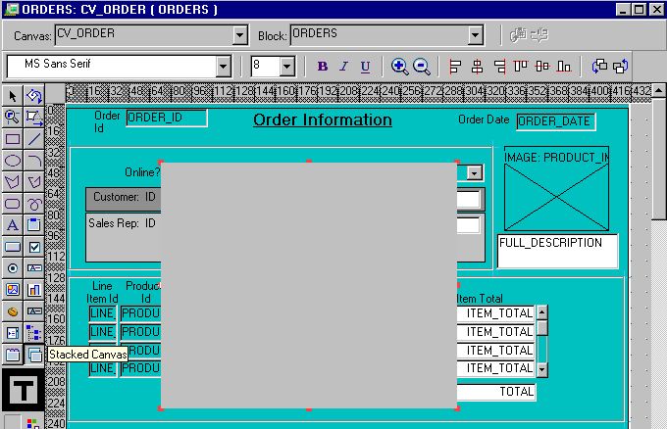
Creating a Stacked Canvas
Notes:
Creating a Stacked Canvas
You can create a stacked canvas in either of the following:
Layout Editor
Object Navigator
How to create a stacked canvas in the Layout Editor
To create a stacked canvas in the Layout Editor, perform the following steps:
1. In the Object Navigator, double-click the object icon for the content canvas on which you wish to create a stacked canvas.
The Layout Editor is displayed.
2. Click the Stacked Canvas tool in the toolbar.
3. Click and drag the mouse in the canvas where you want to position the stacked canvas.
4. Open the Property Palette of the stacked canvas. Set the canvas properties according to your requirements (described later in this lesson).

Slide 7
Notes:
Creating a Stacked Canvas (continued)
How to create a stacked canvas in the Object Navigator
To create a stacked canvas in the Object Navigator, perform the following steps:
1. Click the Canvases node in the Object Navigator.
2. Click the Create icon.
A new canvas entry displays with a default name of CANVASXX.
3. If the Property Palette is not already displayed, click the new canvas entry and select Tools > Property Palette.
4. Set the Canvas Type property to Stacked. Additionally, set the properties that are described later in this lesson according to your requirements.
Note: To convert an existing content canvas to a stacked canvas, change its Canvas Type property value from Content to Stacked.
In order for the stacked canvas to display properly, make sure that its position in the stacking order places it in front of the content canvas assigned to the same window. The stacking order of canvases is defined by the sequence in which they appear in the Object Navigator.
Displaying stacked canvases in the Layout Editor
You can display a stacked canvas as it sits over the content canvas in the Layout Editor. Check the display position of stacked canvases by doing the following:
Select View > Stacked Views in the Layout Editor. The Stacked/Tab Canvases dialog box is displayed, with a list of all the stacked canvases assigned to the same window as the current content canvas.
Select the stacked canvases you want to display in the Layout Editor.
Note: [Ctrl] + click to clear a stacked canvas that was previously selected.
Instructor Note
Demonstration
Create a stacked canvas. Show the stacked canvas in the Layout Editor. Show the stacked canvas at run time.

Slide 8
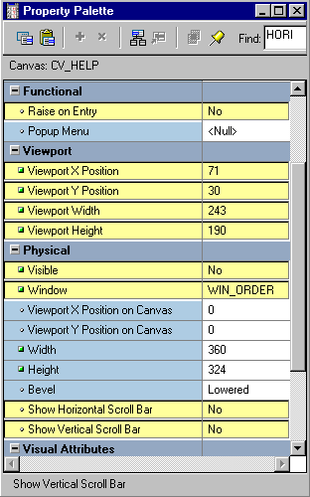
Setting Stacked Canvas Properties
Notes:
Setting Stacked Canvas Properties
There are several properties you can set to affect the appearance and behavior of stacked canvases:
Raise on Entry: Controls how Forms displays the canvas when the user or the application navigates to an item on the canvas
Viewport X/Y Position: Specifies the point at which the upper left corner of the stacked canvas is located in relation to the content canvas
Viewport Width/Height: Determines the size of the stacked canvas displayed at run time
Visible: Indicates whether the stacked canvas is initially displayed or visible; set to Yes or No to show or hide the stacked canvas
Window: Specifies the window in which the canvas will be displayed
Show Horizontal/Vertical Scroll Bar: Specifies whether scrollbars display with the canvas
Note: If a data block contains more items than the window can display, Forms scrolls the window to display items outside the window frame. This can cause important items, such as primary key values, to scroll out of view. By placing important items on a content canvas, and placing the items that can be scrolled out of sight on a stacked canvas, the stacked canvas becomes the scrolling region, rather than the window itself.

Slide 9

The Toolbar Canvas
  Special type of canvas for tool items
  Two types:
    Vertical toolbar
    Horizontal toolbar
  Provide:
    Standard look and feel
    Alternative to menu or function key operation
Notes:
The Toolbar Canvas
A toolbar canvas is a special type of canvas that you can create to hold buttons and other frequently used GUI elements.
Toolbar Types
Vertical toolbar: Use a vertical toolbar to position all your tool items down the left side of your window.
Horizontal toolbar: Use a horizontal toolbar to position all your tool items and controls across the top of your window under the window’s menu bar.
Uses and benefits of toolbars
Toolbar canvases offer the following advantages:
Provide a standard look and feel across canvases displayed in the same window
Decrease form module maintenance time
Increase application usability
Create applications similar to others used in the same environment
Provide an alternative to menu or function-key driven applications

Slide 10

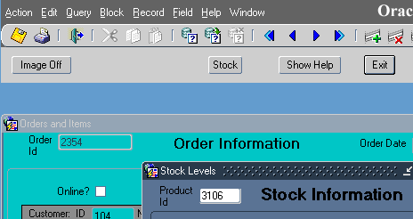


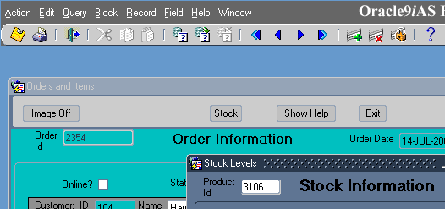
The MDI Toolbar
Runtime parameter: Window property:
useSDI=no
Form property:
Notes:
The MDI Toolbar
You can attach the toolbar to individual windows, or to the form itself. Attaching a toolbar to a form provides an MDI toolbar, so that you do not need to create more than one toolbar for a Forms application that uses multiple windows.
Whether an MDI toolbar is displayed is determined by a combination of Form properties and the useSDI runtime parameter:
If you display a toolbar in the MDI window, the same toolbar will not be duplicated in the individual windows of the form.

Slide 11
Creating a Toolbar Canvas
  1. Create:
    Click Create in Object Navigator
    Change Canvas Type
    Set other properties as required
  2. Add functionality
  3. Resize the canvas (not the view)
  4. Assign to window and/or form
Notes:
Creating a Toolbar Canvas
To create a Toolbar canvas, perform the following steps:
1. Create new or modify the existing canvas:
With the Canvases node selected, use the Create icon in the Object Navigator.
If the Property Palette is not already displayed, click the new canvas entry and select Tools > Property Palette.
Set the Canvas Type to either Horizontal or Vertical Toolbar.
2. Add functionality, usually with push buttons. To avoid problems with unwanted navigation, be sure to set the Mouse Navigate property of any toolbar buttons to No.
3. Resize: Use the Layout Editor to resize the toolbar canvas (not just the view) to the smallest size necessary to display its items.
4. Assign to Window or Form: In Property Palette of window or the Form module, set the Horizontal/Vertical Toolbar Canvas properties.
When toolbars are placed on the form or window, the window manager controls shifting the content canvas downward or to the right in order to display the toolbar. You do not need to leave enough space in the content canvas for the placement of the toolbar.

Slide 12
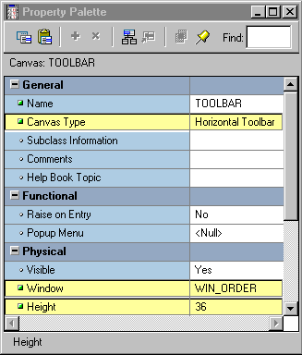
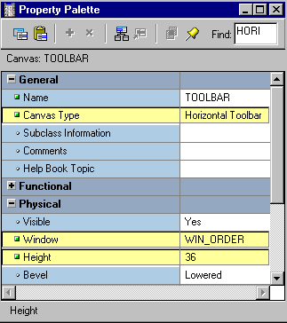
Setting Toolbar Properties
  Canvas properties:
    Canvas Type
    Window
    Width or Height
  Window properties:
    Horizontal Toolbar
    Canvas
    Vertical Toolbar
    Canvas
  Form Module properties:
    Form Horizontal Toolbar Canvas
    Form Vertical Toolbar Canvas
Notes:
Setting Toolbar Properties
Once you create a toolbar canvas, you can set its properties as well as the properties of the associated window or form module:
Canvas Properties:
Canvas Type: Either Horizontal or Vertical Toolbar
Window: Specifies in which window the toolbar displays
Width/Height: Size of canvas. The width of a horizontal toolbar is set to the width of the window (for example, content canvas). Likewise, the height of a vertical toolbar is set to the height of the window.
Window Property
Horizontal/Vertical Toolbar Canvas: Identifies the horizontal/vertical toolbar to display in this window
Form Module Property
Form Horizontal/Vertical Toolbar Canvas: Identifies the horizontal/vertical toolbar to display in the MDI window (when the useSDI runtime parameter is set to No)

Slide 13
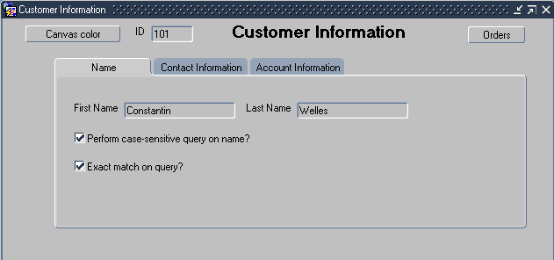
The Tab Canvas
  Enables you to organize and display related information on separate tabs
  Consists of one or more tab pages
  Provides easy access to data
Notes:
The Tab Canvas
What is a tab canvas?
A tab canvas is a a special type of canvas that enables you to organize and display related information on separate tabs. Like stacked canvases, tab canvases are displayed on top of a content canvas.
What is a tab page?
A tab page is a subobject of a tab canvas. Each tab canvas is made up of one or more tab pages. A tab page displays a subset of the information in the entire tab canvas. Each tab page has a labeled tab that end users can click to access information on the page.
Each tab page occupies an equal amount of space on the tab canvas.
Uses and benefits of tab canvases
You can use tab canvases to:
Create an overlay effect within a single window
Display large amounts of information on a single canvas
Hide information
Easily access required information by clicking the tab

Slide 14
Creating a Tab Canvas
  Create in:
    Object Navigator
    Layout Editor
  Define tab pages
  Place items on tab pages
Notes:
Creating a Tab Canvas
To create a functional tab canvas, you must:
Create an empty tab canvas in either of the following:
Object Navigator
Layout Editor
Define one or more tab pages for the tab canvas.
Place items on the tab pages.
Instructor Note
Although it is possible to get rid of a content canvas after creating a tab canvas, it is still highly recommended that there be at least one content canvas for each window in your form application.

Slide 15
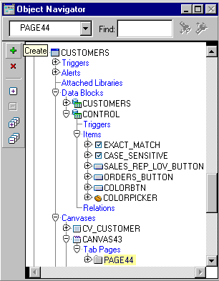
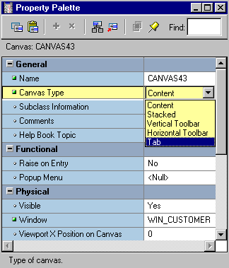
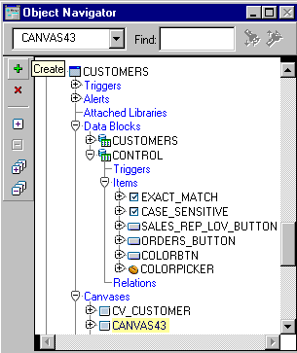
Creating a Tab Canvas in the Object Navigator
Create new
Canvas
Set Canvas Type
Create Tab Pages
Notes:
Creating a Tab Canvas in the Object Navigator
To create a tab canvas in the Object Navigator, perform the following steps:
1. Click the Canvases node in the Object Navigator.
2. Click the Create icon.
A new canvas entry displays.
3. If the Property Palette is not already displayed, click the new canvas entry and select Tools > Property Palette.
4. Set the Canvas Type property to Tab. Additionally, set the canvas properties according to your requirements (described later in the lesson).
5. Expand the canvas node in the Object Navigator.
The Tab Pages node displays.
6. Click the Create icon.
A tab page displays in the Object Navigator, with a default name of PAGEXX. The Property Palette takes on its context.
7. Set the tab page properties according to your requirements (described later in the lesson).
8. Create additional tab pages by repeating steps 6 and 7.

Slide 16
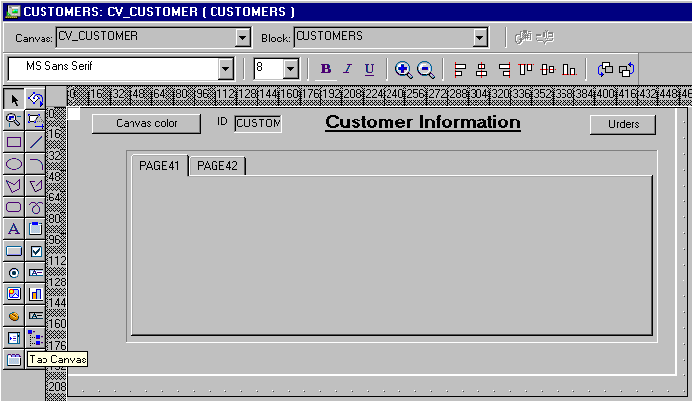
Creating a Tab Canvas in the Layout Editor
Notes:
Creating a Tab Canvas in the Layout Editor
To create a tab canvas in the Layout Editor, perform the following steps:
In the Object Navigator, double-click the object icon for the content canvas on which you want to create a tab canvas.
The Layout Editor displays.
Click the Tab Canvas tool in the toolbar.
3. Click and drag the mouse in the canvas where you want to position the tab canvas.
Forms Builder creates a tab canvas with two tab pages by default.
4. Open the Property Palette of the tab canvas. Set the canvas properties according to your requirements (described later in the lesson).
5. Create additional tab pages, if required, in the Object Navigator.
6. Set the tab page properties according to your requirements (described later in the lesson).

Slide 17
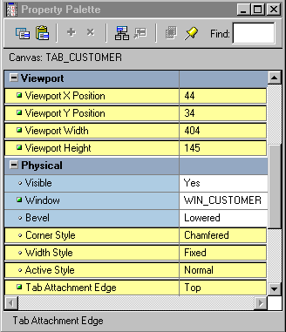
Setting Tab Canvas, Tab Page, and Item Properties
3
1
2
Notes:
Setting Tab Canvas, Tab Page, and Item Properties
Once you create a tab canvas and its tab pages, you must set the required properties for both of these objects. Place items on a tab page by setting the required item properties.
Tab Canvas Properties:
1. Viewport X/Y Position: Specifies the point at which the upper left corner of the tab page is located in relation to the content canvas
2. Viewport Width/Height: Defines the size of tab canvas
3. Corner Style: Specifies the shape of labeled tabs (Chamfered, Square, or Rounded)
Tab Attachment Edge: Where tabs are attached (Top, Bottom, Left, Right, Start, or End)
Width Style: Whether the width of the tab will vary with the length of the label
Active Style: Whether label displays as bold when tab page is active
Tab Page Property: Label specifies label appearing on tab page’s tab
Item Properties:
Canvas: The tab canvas on which the item will be displayed
Tab Page: The tab page on which the item will be displayed

Slide 18
Placing Items on a Tab Canvas
  Place items on each tab page for user interaction.
  Set the item properties:
    Canvas
    Tab Page
Notes:
Placing Items on a Tab Page
Once you create a tab canvas and related tab pages, you place items on the tab pages that the end users can interact with at run time:
Open the Property Palette of the item.
Set the item’s Canvas and Tab Page properties of the item to the desired tab canvas and tab page.
Note: Display the tab canvas as it sits on top of the content canvas, by selecting View > Stacked View in the Layout Editor.
Performance Tip: The time taken to load and initialize a TAB canvas at run time is related to all objects on the canvas and not just to those initially visible.
Instructor Note
When you add an item to a tab page, make sure the entire item is completely within the tab page region. You can resize the tab canvas viewport in the Layout Editor, or in the Property Palette of the tab canvas by changing its Viewport Width and Height properties.

Slide 19
Summary
In this lesson, you should have learned:
  Canvas types other than content canvases:
    Stacked: Overlays and shares window with content canvas; use to create cascading or revealing effect within a single window, display additional information, display or hide information conditionally, or display context-sensitive help
    Toolbar: Area that displays at the top or to the left of a content canvas; use to to hold buttons and other frequently used GUI elements with a standard look and feel across canvases displayed in the same window
    Tab: Has multiple pages where you navigate using tabs; use to organize and display related information on different tabs
Notes:
Summary
In this lesson, you should have learned to:
Create an overlay effect with a stacked canvas
Create a toolbar
Create a tabbed canvas

Slide 20
Summary
  You can create these in Object Navigator and change the canvas type, then set properties.
  You can create stacked or tab canvases with the appropriate tool in the Layout Editor.
  You can attach a Toolbar canvas to single window, or to entire form if using MDI.
  After creating a tab canvas, create tab pages and place related items on them.

Slide 21
Practice 11 Overview
This practice covers the following topics:
  Creating a toolbar canvas
  Creating a stacked canvas
  Creating a tab canvas
  Adding tab pages to the tab canvas
Notes:
Practice 11 Overview
In this practice session, you will create different types of canvases: stacked canvas, toolbar canvas, and tab canvas.
Create a horizontal toolbar canvas in the ORDERS form. Create new buttons in the Control block, and place them on the horizontal toolbar. Save and run the form.
Create a stacked canvas in the ORDERS form to add some help text. Position the canvas in the center of the window. Create a button in the Control block. This button will be used later to display the stacked canvas. Add help text on the stacked canvas. Save and run the form.
Create a tab canvas in the CUSTOMERS form. Create three tab pages on this canvas, and make sure that each tab page displays the appropriate information. Save and run the form.
Note
For solutions to this practice, see Practice 11 in Appendix A, “Practice Solutions.”

Slide 22
Notes:
Practice 11
Toolbar Canvases
1. In the ORDGXX form, create a horizontal toolbar canvas called Toolbar in the WIN_ORDER window, and make it the standard toolbar for that window. Suggested height is 30.
2. Save, compile, and run the form to test.
Notice that the toolbar now uses part of the window space. Adjust the window size accordingly.
3. Create three push buttons in the CONTROL block, as shown in the following table, and place them on the Toolbar canvas.
Suggested positions for the push buttons are shown in the illustration.

Slide 23
Notes:
Practice 11 (continued)
Stacked Canvases
4. Create a stacked canvas named CV_HELP to display help in the WIN_ORDER window of the ORDGXX form. Suggested visible size is Viewport Width 250, Viewport Height 225 (points). Select a contrasting color for the canvas. Place some application help text on this canvas, similar to that shown:
5. Position the view of the stacked canvas so that it appears in the center of WIN_ORDER. Ensure that it will not obscure the first enterable item.
Do this by planning the top-left position of the view in the Layout Editor, while showing CV_ORDER. Define the Viewport X and Viewport Y Positions in the Property Palette. You can move and resize the view in the Layout Editor to set the positions.
6. Organize CV_HELP so that it is the last canvas in sequence.
Do this in the Object Navigator. (This ensures the correct stacking order at run time.)
7. Save and compile the form. Click Run Form to run the form and test the changes. Note that the stacked canvas is displayed all the time, providing that it does not obscure the current item in the form.
8. Switch off the Visible property of CV_HELP, and then create a push button in the CONTROL block to hide the Help information when it is no longer needed. You will add the code later. Display this push button on the CV_HELP canvas.

Slide 24
Notes:
Practice 11 (continued)
Tab Canvases
Modify the CUSTGXX form in order to use a tab canvas:
9. In the Layout Editor, delete the frame object that covers the CUSTOMERS block.
Create a tab canvas (you may need to first enlarge the content canvas).
In the Property Palette, set the Background Color property to gray, Corner Style property to Square, and Bevel property to None.
10. Rename the TAB_CUSTOMER tab canvas. Create another tab page in addition to the two tab pages created by default. Name the tab pages as Name, Contact, and Account. Label them as Name, Contact Information, and Account Information.
11. Design the tab pages according to the following screenshots. Set the item properties to make them display on the relevant tab pages.
Instructor Note
If students appear to “lose” items after setting their Canvas properties, have them set the items’ X and Y positions to 0 to move them to the upper left of the tab page, where they can be seen.

Slide 25
Notes:
Practice 11 (continued)
Tab Canvases (continued)
12. Reorder the items according to the tab page sequence. Ensure that the user moves smoothly from one tab page to another when tabbing through items. Set the Next Navigation Item and Previous Navigation Item properties to make it impossible to tab to the Customer_Id item.
Note: Since Customer_Id is now the only item on the CV_CUSTOMER canvas, setting either its Enabled or Keyboard Navigable properties to No has the effect of making the item not visible. This is because Forms must be able to navigate to an item on a canvas in order to display that canvas’ items.
13. Save and compile the form. Click Run Form to run the form.

